Slide 1

Network and Graph Science Analytics
Experimental evaluation of community detection algorithms for musical tastes predictions

Slide 2
Table of contents
1
Problem definition
2
Methodology & Evaluation
3
GEMSEC (theory)
4
Impact of each layer
5
Performance vs other algorithms
6
Appendix

Slide 3



Problem definition
1
2
3
4
5
Our project aims at evaluating community detection methods applied to a musical network
Such algorithms could be used to improve recommendation systems
OBJECTIVE
APPLICATIONS
APPROACH
Improving the identification of communities within a musical network to better understand users, their tastes, and how they are related
Generating musical recommendations
(new genres and artists)
Testing different existing community detection methods (classical and new ones) and compare their performance on this specific network
Suggesting new relationships

Slide 4

Methodology & Evaluation
1
2
3
4
5
Community detection will be achieved and evaluated thanks to 2 types of methods
Algorithms will be applied on Deezer dataset and compared based on 2 criteria : modularity and F1-score on a classification task
Deezer dataset
CLASSICAL GRAPH CLUSTERING METHODS
COMMUNITIES
3 datasets :
Romania, Croatia, Hungary
Fast Greedy
Spectral clustering
Walktrap
Label propagation
Louvain
Evaluation based on modularity
>
EMBEDDING BASED METHODS
NODES EMBEDDINGS
Nodes = Users
Nodes attributes = Musical tastes
Edges = Friendships
Node2Vec
Deep Walk
GEMSEC
Evaluation based on F1-score on a multi-label classification task

Slide 5
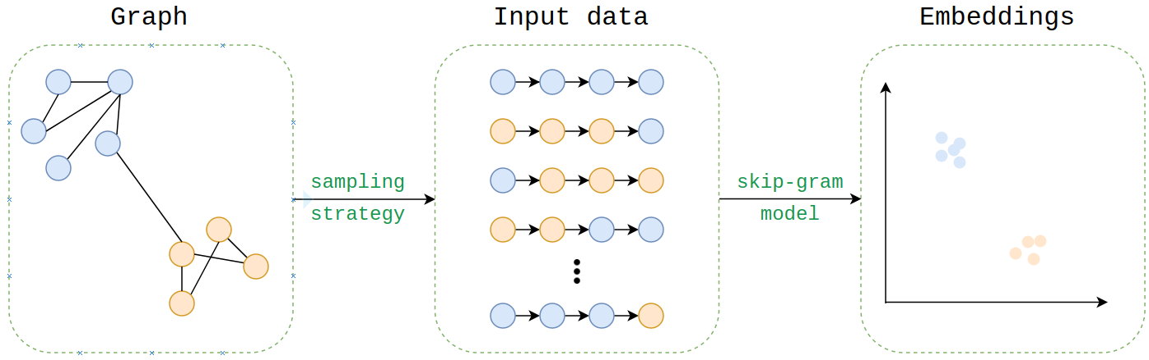
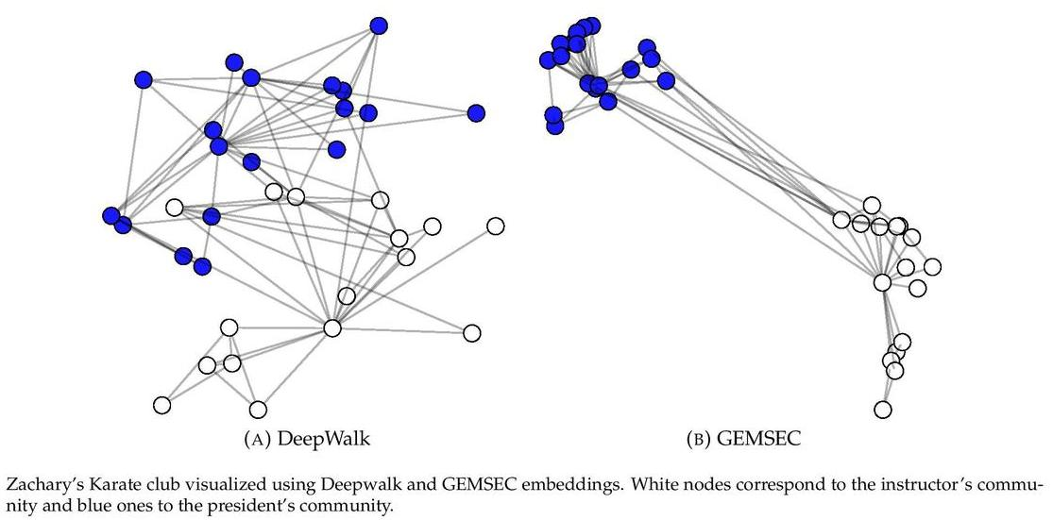
GEMSEC Theory
1
2
3
4
5
Graph Embeddings with Self Clustering
Graph embeddings techniques and purposes
Graph embeddings
GEMSEC
Objective : to create a representation of the graph in a vector space which can later be used for machine learning applications
Examples: Deepwalk, Node2vec, …
Definition: Graph embeddings methods which learns a clustering of the nodes while computing their embedding for community detection purposes.
Objective : to represent intra-community node close while separating different communities
>
Graph
Embeddings
Classical embeddings
Gemsec embeddings

Slide 6


GEMSEC Theory
1
2
3
4
5
Main concepts
GEMSEC algorithm is composed of 3 parts
Deepwalk
Clustering
Regularization
For each node of the graph, multiple random walks are applieds in order to generated a corpus of node sequences. This corpus is then use as an input of a skip-gram model to generate embeddings.
Objective : to generate node features consistent with the graph structure.
At each step, we measure the distance from the node features (generated by deepwalk) to each clusters centers and use it as a clustering cost.
Objective : to minimize the distance from each node to its nearest cluster center.
At each step, a regularisation cost is added to the loss function where the norm of connected nodes is weighted by their common jaccard coefficient.
Objective : to incorporate social networks properties to find more natural embeddings and clusters.
By minimizing the resulting loss function, Gemsec generates embeddings that are community based

Slide 7

Impact of each layer
1
2
3
4
5
Layer description
Each layer contributes to improving embedding and clustering tasks
ALGORITHM
RANDOM
WALKS
CLUSTERING
REGULARIZATION
DEEPWALK
DEEPWALK with Regularization
GEMSEC
GEMSEC with Regularization

Slide 8
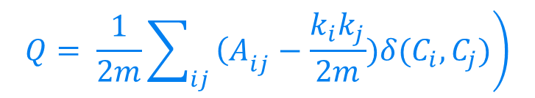
Impact of each layer
1
2
3
4
5
Performance associated to each layer - modularity
GEMSEC with regularization has the better modularity score for all 3 tested datasets
CRITERIA TO EVALUATE PERFORMANCE : MODULARITY
$$Q= \frac{1}{2m}\sum_{ij}{\left.{\left(A\right.}_{ij}−\frac{k_{i}k_{j}}{2m})δ(C_{i},C_{j})\right)}$$
MODULARITY SCORES ON DEEZER DATASETS
ALGORITHM
CROATIA
HUNGARY
ROMANIA
DEEPWALK
0.235
0.275
0.468
PERFORMANCE
DEEPWALK with Regularization
0.287
0.292
0.484
GEMSEC
0.354
0.351
0.543
GEMSEC with Regularization
0.407
0.409
0.549

Slide 9

Performance vs. other algorithms
1
2
3
4
5
Multi-label classification: music genres prediction
Method and Performance on the multilabel classification task with a OneVsAll approach (LogisticRegression)
Deezer Datasets
Embeddings (Node2Vec, GEMSEC, etc.)
Fitted model (OneVsAll with Logistic Regression)
Predictions
(Genres liked per user)
Embedded
Training⁽¹⁾
Testing⁽²⁾
Country | Croatia |  |  | Hungary |  |  | Romania
F1-Score | Macro | Micro | Weighted | Macro | Micro | Weighted | Macro | Micro | Weighted
Node2Vec | 2.32% | 24.03% | 12.93% | 3.92% | 33.78% | 18.34% | 3.90% | 33.45% | 18.11%
Laplacian Eigenmaps | 2.32% | 23.80% | 12.79% | 3.97% | 33.88% | 18.46% | 3.92% | 32.99% | 17.74%
MNMF | 4.70% | 31.72% | 20.20% | 5.40% | 35.97% | 22.66% | 5.04% | 33.74% | 21.02%
DANMF | 3.52% | 27.20% | 16.56% | 4.74% | 35.32% | 20.78% | 4.11% | 33.01% | 18.37%
DeepWalk | 4.99% | 32.56% | 21.05% | 6.19% | 37.84% | 24.97% | 4.95% | 32.33% | 20.68%
DeepWalk With Regularization | 4.90% | 32.57% | 20.88% | 6.16% | 37.88% | 25.13% | 4.79% | 31.93% | 20.19%
GEMSEC | 4.83% | 32.30% | 20.54% | 6.19% | 37.31% | 24.62% | 4.96% | 32.49% | 20.59%
GEMSEC With Regularization | 5.00% | 32.76% | 21.09% | 6.35% | 38.61% | 25.71% | 4.88% | 32.01% | 20.35%
Notes: (1) Models were trained on 90% of the datasets; (2) Models were tested on the 10% remaining data

Slide 10
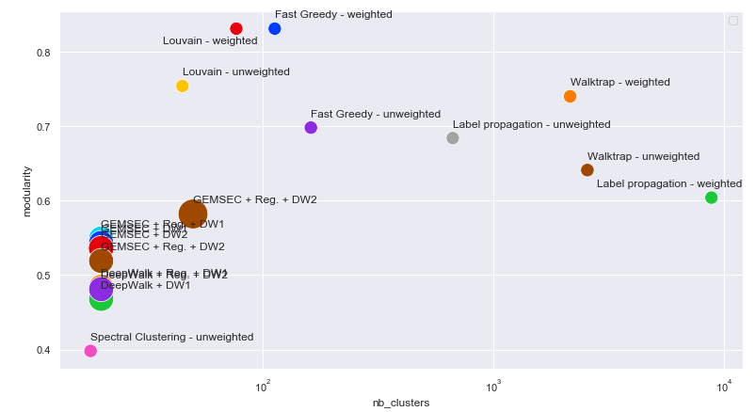

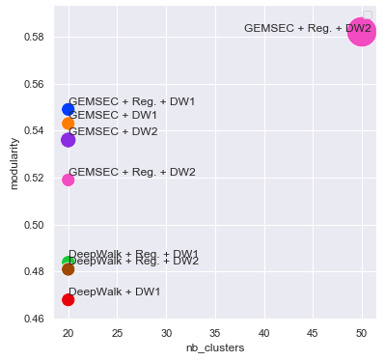
Performance vs. other algorithms
1
2
3
4
5
Modularity
GEMSEC is slightly less interesting than other well used community detection algorithms
CRITERIA TO EVALUATE PERFORMANCE : MODULARITY
OTHER ALGORITHMS USED FOR COMPARISON
Fast Greedy
Spectral clustering
Walktrap
Label propagation
Louvain
ZOOM ON GEMSEC RESULTS
TAKEAWAYS
GEMSEC is slightly less interesting than other well used community detection algorithms
First order random walks are performing better than second order ones
Only GEMSEC, Louvain and Fast Greedy predict accurate numbers of clusters, and are then suited for our musical taste problem.

Slide 11
APPENDIX

Slide 12
Performance vs. other algorithms
Multi-label classification: music genres prediction
Method and Performance on the multilabel classification task with a OneVsAll approach (Gradient Boosting)
Country | Croatia |  |  | Hungary |  |  | Romania
F1-Score | Macro | Micro | Weighted | Macro | Micro | Weighted | Macro | Micro | Weighted
Node2Vec | 3.95% | 29.51% | 18.12% | 4.44% | 33.58% | 19.44% | 3.88% | 30.94% | 17.63%
Laplacian Eigenmaps | 4.65% | 32.73% | 20.68% | 5.70% | 36.74% | 23.18% | 4.40% | 31.42% | 19.20%
MNMF | 4.55% | 31.21% | 19.39% | 6.27% | 38.75% | 25.48% | 5.20% | 33.52% | 21.60%
DANMF | 5.05% | 32.16% | 21.03% | 5.67% | 36.61% | 23.51% | 5.34% | 33.62% | 21.80%
DeepWalk | 4.98% | 32.51% | 21.20% | 6.04% | 37.30% | 24.55% | 5.13% | 32.18% | 20.90%
DeepWalk With Regularization | 5.03% | 32.53% | 21.25% | 6.08% | 37.25% | 24.59% | 5.07% | 33.48% | 21.80%
GEMSEC | 5.04% | 32.59% | 21.37% | 5.96% | 37.47% | 24.63% | 5.05% | 31.88% | 20.71%
GEMSEC With Regularization | 5.03% | 32.46% | 21.27% | 6.02% | 36.77% | 24.11% | 5.06% | 32.85% | 21.30%
Notes: (1) Models were trained on 90% of the datasets; (2) Models were tested on the 10% remaining data

Slide 13
Performance vs. other algorithms
Multi-label classification: music genres prediction
Method and Performance on the multilabel classification task with a ClassifierChain approach (LogisticRegression)
Country | Croatia |  |  | Hungary |  |  | Romania
F1-Score | Macro | Micro | Weighted | Macro | Micro | Weighted | Macro | Micro | Weighted
Node2Vec | 2.33% | 24.14% | 13.04% | 3.97% | 33.62% | 18.26% | 3.89% | 32.90% | 17.70%
Laplacian Eigenmaps | 17.74% | 44.34% | 44.30% | 18.11% | 43.34% | 45.53% | 16.70% | 41.98% | 42.62%
MNMF | 17.56% | 42.16% | 42.97% | 18.51% | 42.86% | 45.69% | 18.36% | 41.62% | 43.37%
DANMF | 18.69% | 43.86% | 44.67% | 17.89% | 42.91% | 45.36% | 17.69% | 42.08% | 43.37%
DeepWalk | 19.12% | 43.21% | 43.52% | 18.67% | 42.72% | 45.65% | 20.10% | 42.27% | 44.05%
DeepWalk With Regularization | 18.98% | 42.70% | 43.13% | 18.73% | 42.45% | 45.73% | 19.40% | 41.05% | 43.66%
GEMSEC | 18.62% | 42.38% | 43.21% | 19.33% | 43.81% | 46.41% | 20.01% | 41.52% | 43.62%
GEMSEC With Regularization | 18.40% | 42.27% | 42.79% | 18.94% | 42.61% | 45.78% | 19.43% | 41.78% | 43.38%
Notes: (1) Models were trained on 90% of the datasets; (2) Models were tested on the 10% remaining data

Slide 14
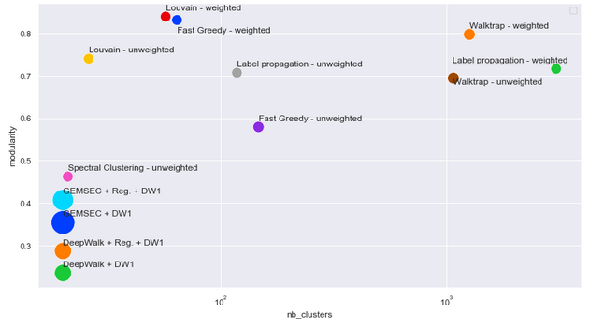
APPENDIX : RESULTS FOR DEEZER DATASET - CROATIA
Scope of study
Results for deezer dataset (Croatia)
Algorithms
Louvain
Walktrap
Label Propagation
Fast Greedy
Spectral Clustering
Types
Weighted
Unweighted
Datasets
Deezer Croatia
Deezer Romania
Deezer Hungary
Legend
The bigger the bubble, the higher the computational time is (from 0 to 2h30)
April 2020
Page 14

Slide 15
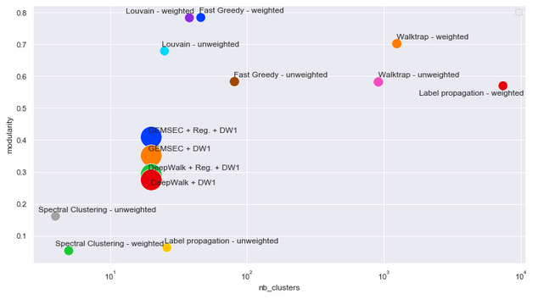
APPENDIX : RESULTS FOR DEEZER DATASET - HUNGARY
Scope of study
Results for deezer dataset (Hungary)
Algorithms
Louvain
Walktrap
Label Propagation
Fast Greedy
Spectral Clustering
Types
Weighted
Unweighted
Datasets
Deezer Croatia
Deezer Romania
Deezer Hungary
Legend
The bigger the bubble, the higher the computational time is (from 0 to 2h30)
April 2020
Page 15

Slide 16
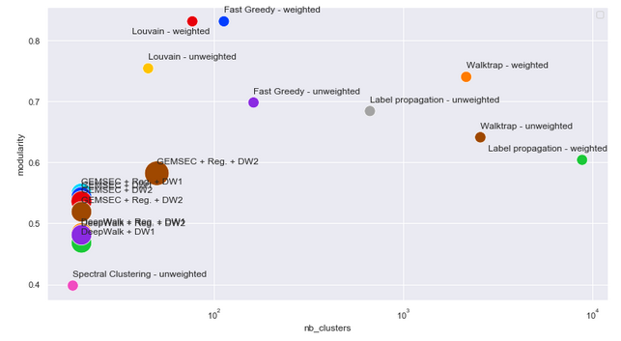
APPENDIX : RESULTS FOR DEEZER DATASET - ROMANIA
Scope of study
Results for deezer dataset (Romania)
Algorithms
Louvain
Walktrap
Label Propagation
Fast Greedy
Spectral Clustering
Types
Weighted
Unweighted
Datasets
Deezer Croatia
Deezer Romania
Deezer Hungary
Legend
The bigger the bubble, the higher the computational time is (from 0 to 2h30)
April 2020
Page 16

